Slide 1




Simplified Telemetry Framework for the Freescale Cup
Daniel C. Castro, Matt Douthwaite, Sanket Kamthe

Slide 2
Outline
Introduction
Bluetooth Communication
Additional Sensors
RPM
Ambient Light
Deliverables and Conclusion

Slide 3
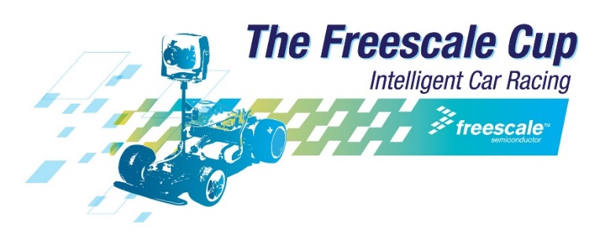

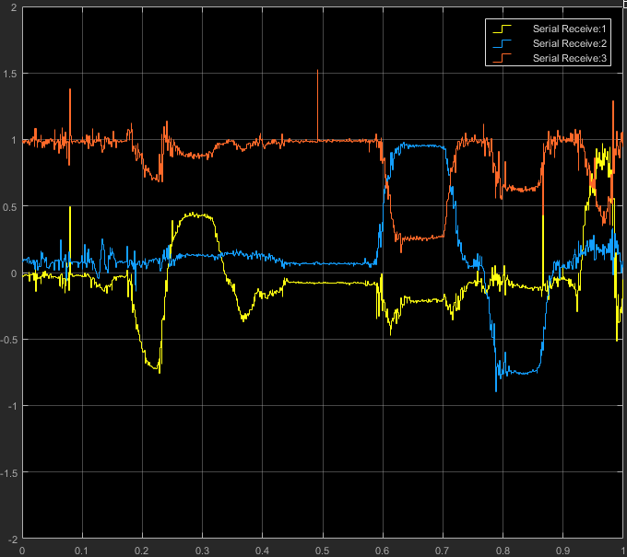
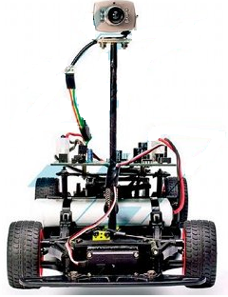

Introduction
Freescale Cup: autonomous racing car competition
Advanced teams develop custom technological solutions
Majority relies on trial and error
We propose an accessible wireless framework to acquire real-time feedback from multiple sensors.

Slide 4
Bluetooth Communication

Slide 5

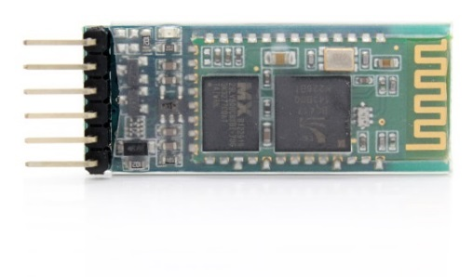
Bluetooth Technology
Invented by Ericsson as an wireless alternative to the RS-232 protocol
Short range, low power radio communication
Widely used, over 3.5 Billion devices shipped in 2015
Bluetooth derives many properties from RS-232/serial protocol
8-bit buffered data stream
Asynchronous serial communication
HC-05 is a well-known and cost-effective Bluetooth module
1 cm

Slide 6
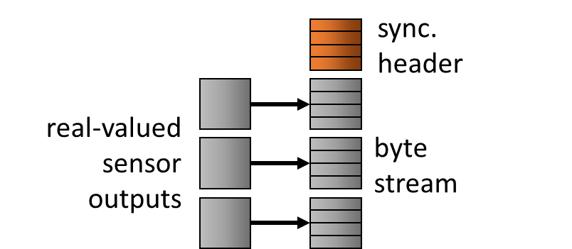
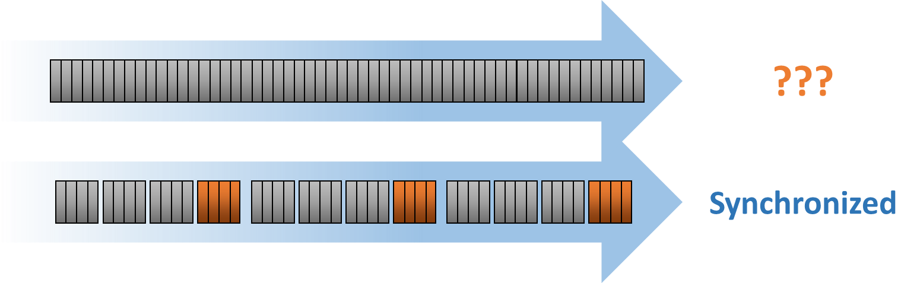


Asynchronous Communication
Data is transmitted as a continuous stream of bytes
Byte alignment is crucial!
$$=0.87$$
A3
FD
7A
37
03
DA
D7
EB
3F
$$=−3.03×{10}^{211}$$
Packet structure to ensure proper alignment

Slide 7
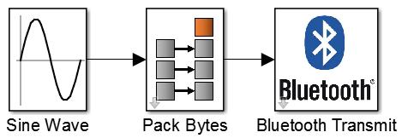
Transmitting Simulink Blocks
Pack Bytes block
In: stream of 64-bit double precision real-valued data
Out: stream of 8x 8-bit vectors
Bluetooth Transmit block
Sends these bytes at the chosen Baud rate

Slide 8
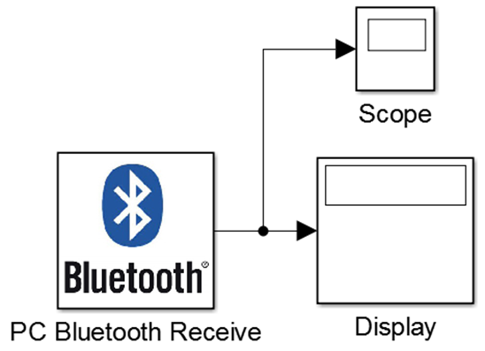
Receiving Simulink Blocks
PC Bluetooth Receive block
Pairs (first time) and connects to the HC-05
Align byte stream into packet structure
Convert back into real-valued stream

Slide 9
Additional Sensors

Slide 10
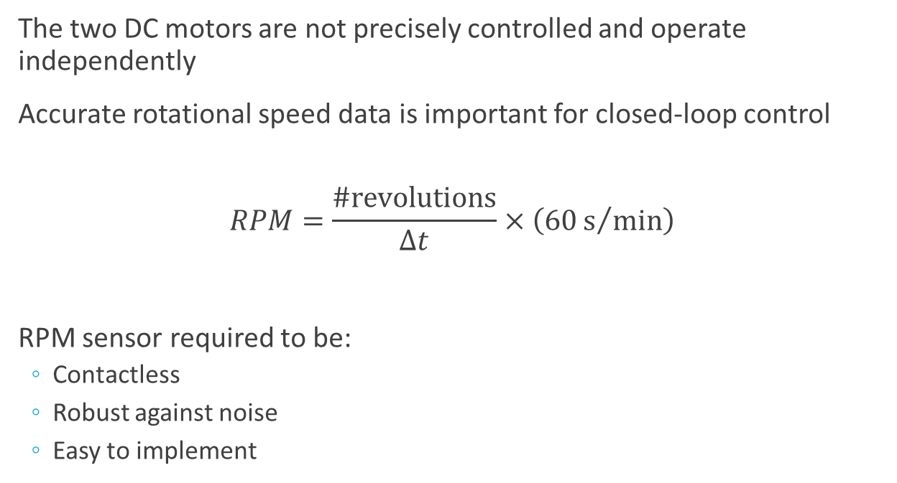
Measuring RPM
The two DC motors are not precisely controlled and operate independently
Accurate rotational speed data is important for closed-loop control
$$RPM=\frac{\#revolutions}{Δt}×\left(60s/{min}\right)$$
RPM sensor required to be:
Contactless
Robust against noise
Easy to implement

Slide 11
RPM Sensors
Infrared Sensor
Detects a reflective surface
Advantage:
Will not affect rotation
Disadvantage:
Requires more external circuitry
Sensitive to noise
Hall Effect Sensor
Detects a magnetic field
Advantages:
Digital output robust to noise
Widely used solution
Disadvantage:
Might interfere with rotation

Slide 12
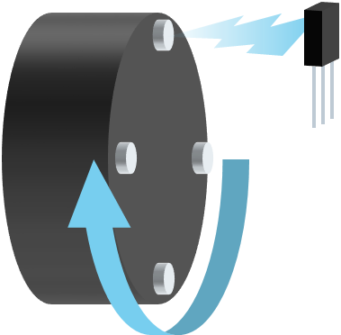
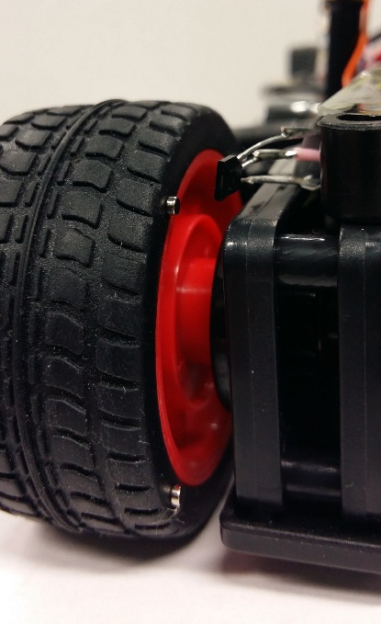
Hall Effect Implementation
V_{out} (V)
3.3
0
Time
RPM
Time

Slide 13
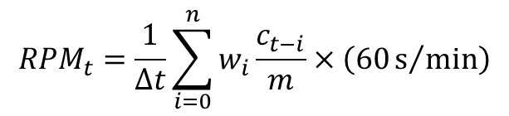

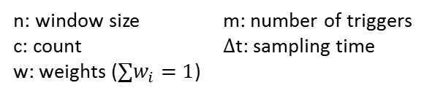

RPM Simulink Block
Readings initially too noisy
Designed a filtering algorithm to smooth results
Exponential window: fast response to sudden changes
$↑$ sampling time: $↓$ noise, $↓$ time resolution
$↑$ triggers (magnets): $↓$ quantization
$${RPM}_{t}=\frac{1}{Δt}\sum_{i=0}^{n}{w_{i}\frac{c_{t−i}}{m}}×\left(60s/{min}\right)$$
w
c
n: window size
c: count
w: weights ($∑w_{i}=1$)
m: number of triggers
$Δ$t: sampling time
t-n
…
t-2
t-1
t
$Δ$t
window size

Slide 14
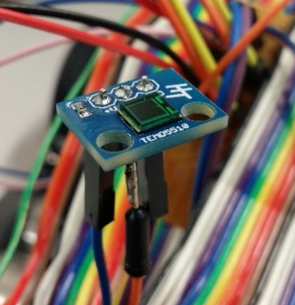
Measuring Ambient Light
Varying light conditions around the track interfere with the camera
Enables robust, adaptive line tracking
Analogue photodiode sensitive to visible light

Slide 15
Deliverables and Conclusion

Slide 16
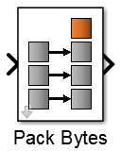
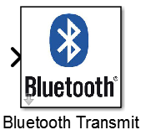

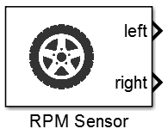
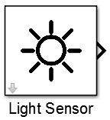
Deliverables
Hardware guidelines
To physically set up and connect Bluetooth module and sensors
Bluetooth Simulink blocks
Sensors Simulink blocks
Simulink
MATLAB
C++
Hardware
Implementation stack

Slide 17
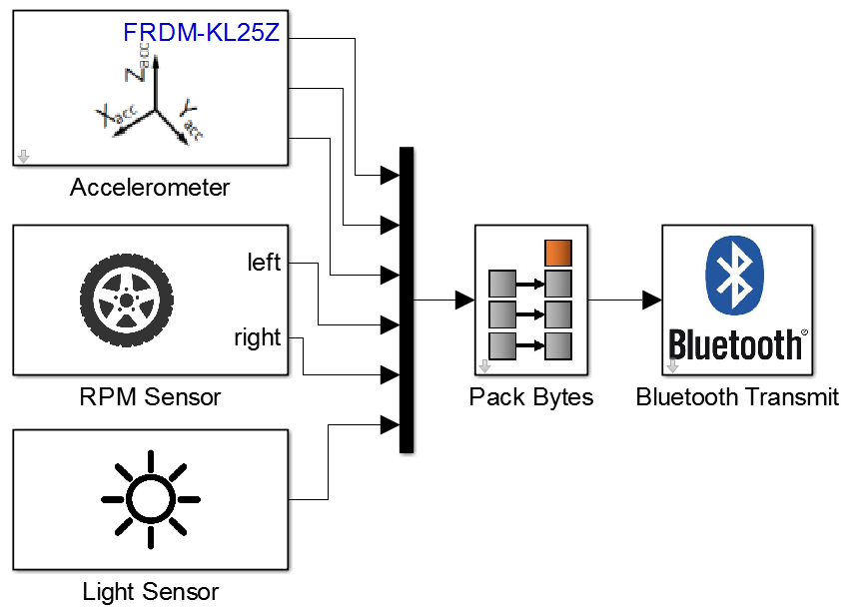

Example setup
Freedom Board (Car)
PC

Slide 18
Conclusion
We provide:
A simplified end-to-end telemetry framework
Two additional sensors not originally available on the Freedom Board
Our contribution for Freescale Cup competitors:
Enable real-time data collection for performance analysis
Help them develop smarter closed-loop control for their cars
Possible future developments:
Bidirectional communication for tuning the controller on the fly
Improve physical access to hardware ports

Slide 19
Thank you!
Questions?

